Slide 1
Configuring your own Linux IPA Server

Slide 2
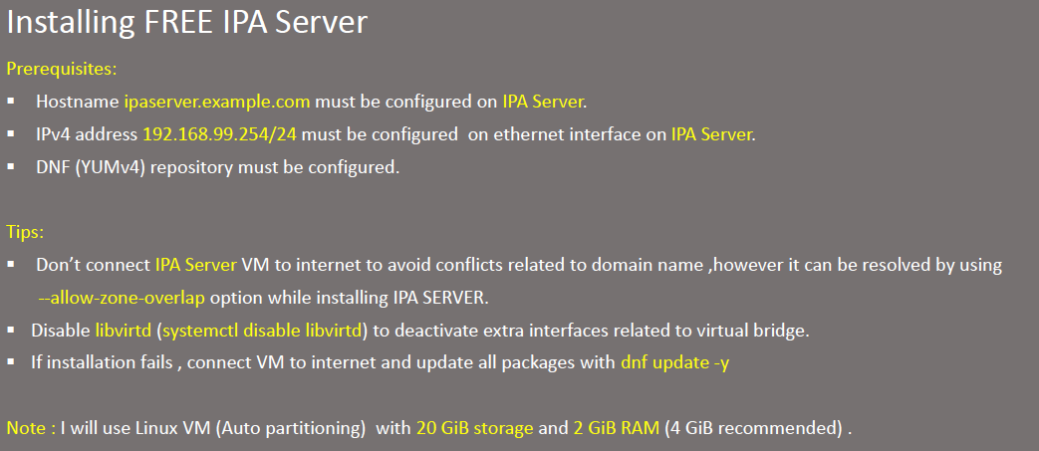

Slide 3
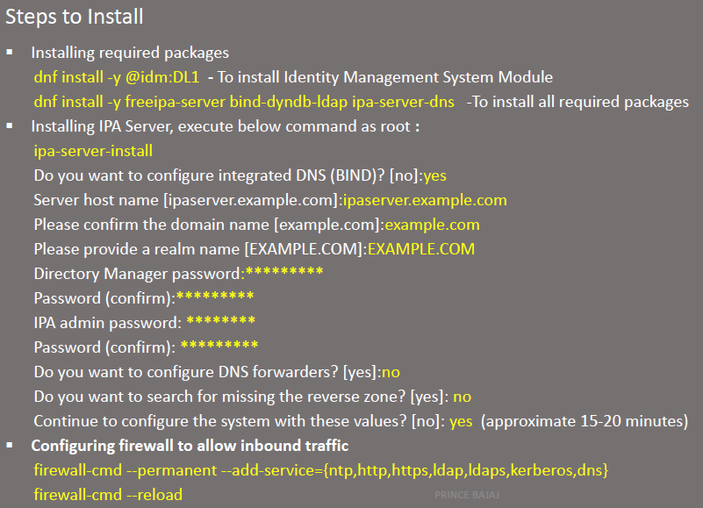

Slide 4
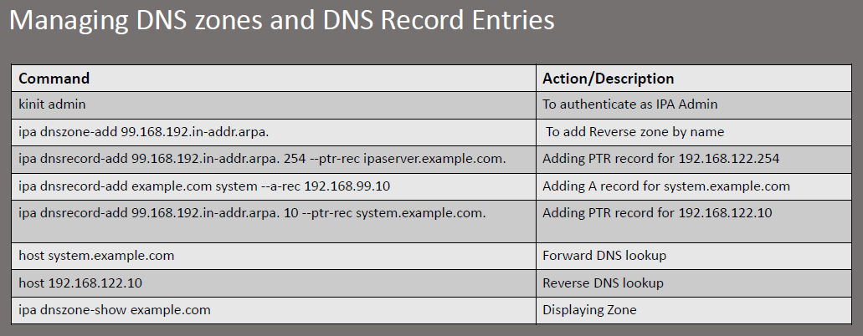

Slide 5
